Slide 1
The Comparative Statics and Dynamics of Beliefs:
The Effect of
Message Discrepancy and Source Credibility
Sungeun Chung
Western Illinois Univ.
Edward L. Fink
Univ. of Maryland
Stan A. Kaplowitz
Michigan State Univ.

Slide 2
A New Model:
Keywords
Belief Change
Mathematical Model
Message Discrepancy and Source Credibility
Comparative Statics
Dynamics
Belief Trajectories

Slide 3
A New Model: Overview
Comparative Statics
  Laroche’s (1977) nonlinear model of belief change by discrepancy and source credibility.
Dynamics of Belief Change
  Single-push with friction model (SPF; Kaplowitz, Fink, & Bauer, 1983).
Comparative Statics and Dynamic Belief Change: A New Model
  Laroche’s model + SPF.

Slide 4
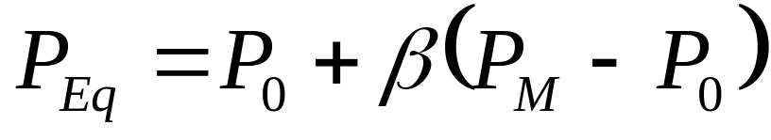

Comparative Statics: Nonmonotonicity of Belief Change on Message Discrepancy
Distance-proportional model:
where P_{EQ} is the new equilibrium position, P_{M} is the message position, P₀ is the initial position, and is a
coefficient to be estimated.
Model is linear and relation between discrepancy and belief change is therefore monotonic.

Slide 5
Bochner & Insko’s (1966) Hypotheses
More credible source always more effective than less credible source.
After some level of discrepancy, curve of opinion change turns down (nonmonotonicity).
Curve for more credible source turns down at higher level of discrepancy than curve for less credible source.
Disparagement is alternative to opinion change.

Slide 6
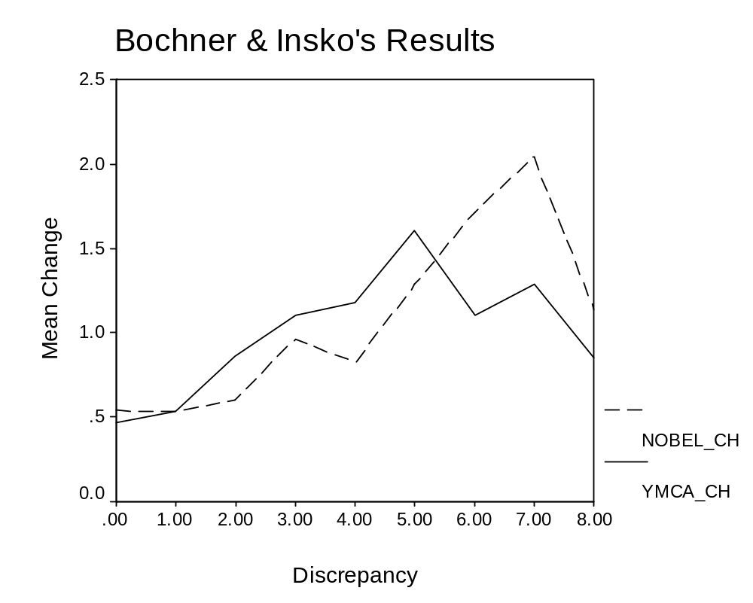
Bochner & Insko’s (1966) Results

Slide 7
Notation for Laroche (1977)
D_{P} = discrepancy.
C = source credibility.
NI = noninvolvement.
γ = - k ln(C) – k’ ln(NI),
and γ is ≥ 0.
y_{Eq} =amount of belief change at equilibrium from initial position.

Slide 8
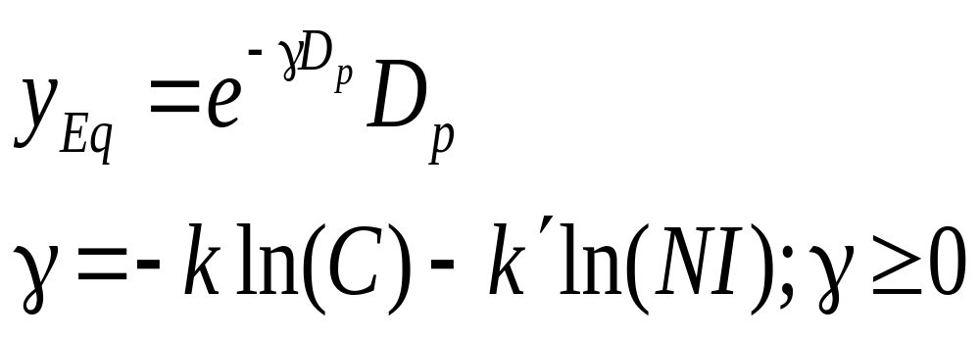
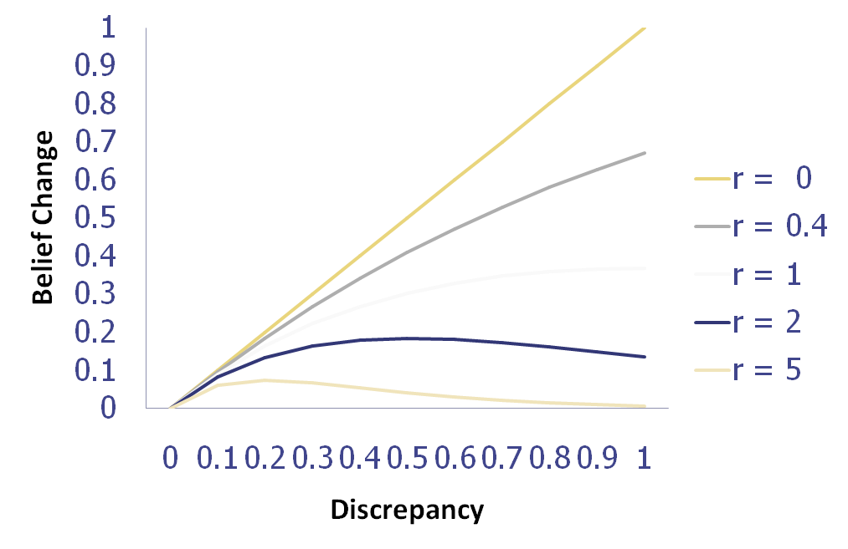
Model of Comparative Statics: Laroche’s Nonlinear Model

Slide 9
Model of Dynamic Belief Change: Single Push with Friction Model
Mechanical metaphor for cognitive system:
  Belief change: A motion of a concept in the cognitive space governed by Newtonian mechanics.
Use a differential equation for belief change as a function of the mass of the concept and time.
Concepts linked → Oscillation (not tested here).

Slide 10
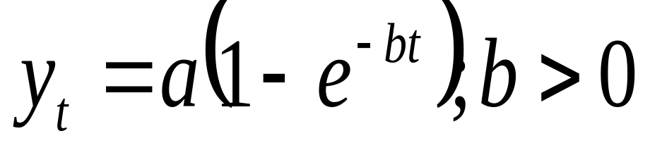

Single Push with Friction Model
t = time.
y_{t} = belief change from the initial position at a certain time point t.
a: coefficient that reflects the amount of belief change at the new equilibrium position.
b: positive coefficient of the rate of deceleration.
Notes:
In this model, the amount of belief change is initially zero (i.e., when t = 0, y_{t} = 0) but approaches as time increases (i.e., as t → ∞, y_{t} → ).

Slide 11
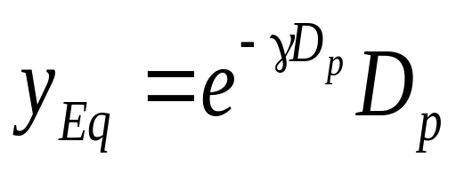
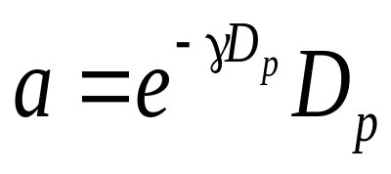
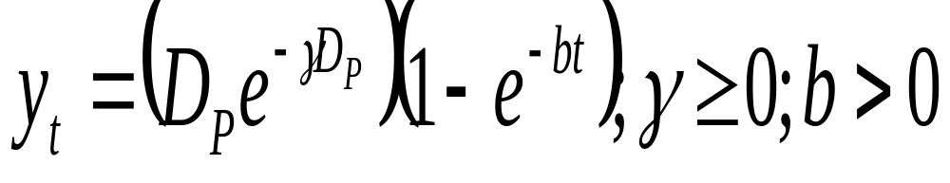
Extended Model: Statics + Dynamics
Laroche’s static model:
Single Push with Friction Model:
Extended model:

Slide 12
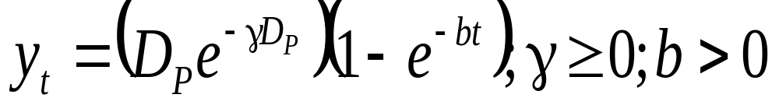
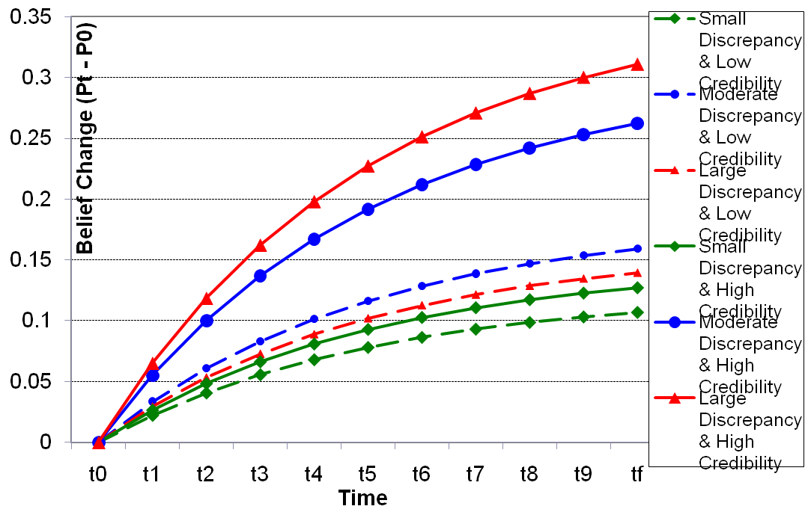
Extended Model

Slide 13
Hypotheses
H1 (Time): Belief change is monotonic but decelerating function of time (b > 0).
H2a (Effect of message discrepancy for low-credibility source): Nonmonotonic (γ > 1.0).
H2b (Effect of message discrepancy for high-credibility source): Monotonic (0<γ< 1).
Cognitive responses & alternative view:
H1_{ALT} Push with Pullback Model.

Slide 14
Method
N = 95.
Topic:
  Criminal-sentencing issue about an armed robbery.
  Tuition-increase issue.
IVs:
  Message discrepancy (small, moderate, & extreme).
  Source credibility (low & high).
DV: Belief
  Measured every 77 ms using a computer-mouse technique.

Slide 15
Message Discrepancy
Criminal sentencing: The judge’s sentence for the defendant:
  Extreme: 50 years.
  Moderate: 30 years.
  Small: 17 years.
  (Initial Position: 10 years.)
Tuition increase: The advocated tuition increase:
  Extreme: 22%.
  Moderate: 15%.
  Small: 9%.
  (Initial position: 0% increase.)
Notes:
In a pilot study, the median position for a tuition increase was found to be 10 years. The levels of discrepancies here were created based on the value.
In the study, the initial position was measured. The mean was 10.12. Using initial position, individual message discrepancy was obtained by subtracting receiver’s initial position from message position.

Slide 16
Source Credibility
Criminal sentencing: The judge’s reputation
  High: “One of the MOST respected judges in Michigan.”
  Low: “NOT one of the more respected judges in Michigan.”
Tuition increase: Legislator, the writer of the statement
  High: “Praised by student groups.”
  Low: “knowledge and willingness to be fair were often questioned.”
  Manipulation checks successful.

Slide 17
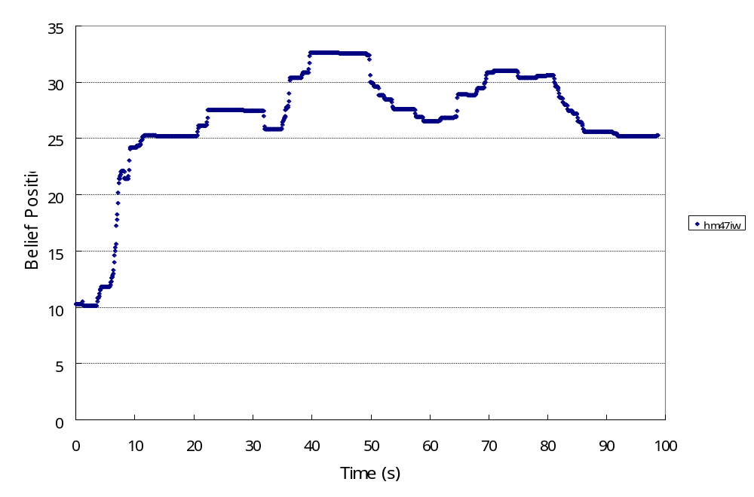
Belief Change: A trajectory
Total number of time points:
Criminal: M = 629.67 (48.48 s).
Min = 111; Max = 1,908.
Tuition: M = 629.31 (48.46 s).
Min = 51; Max = 1,964.
11 Time points used:
t₀ = starting point.
t₁ = 10-percentile time point.
t₂ = 20-percentile time point . . .
t_{f} = the last time point.
Notes:
This is a belief trajectory in criminal sentencing issue:
Initial position was 10. final position is around 25. it took about 1 min 40 second to complete judgment.

Slide 18
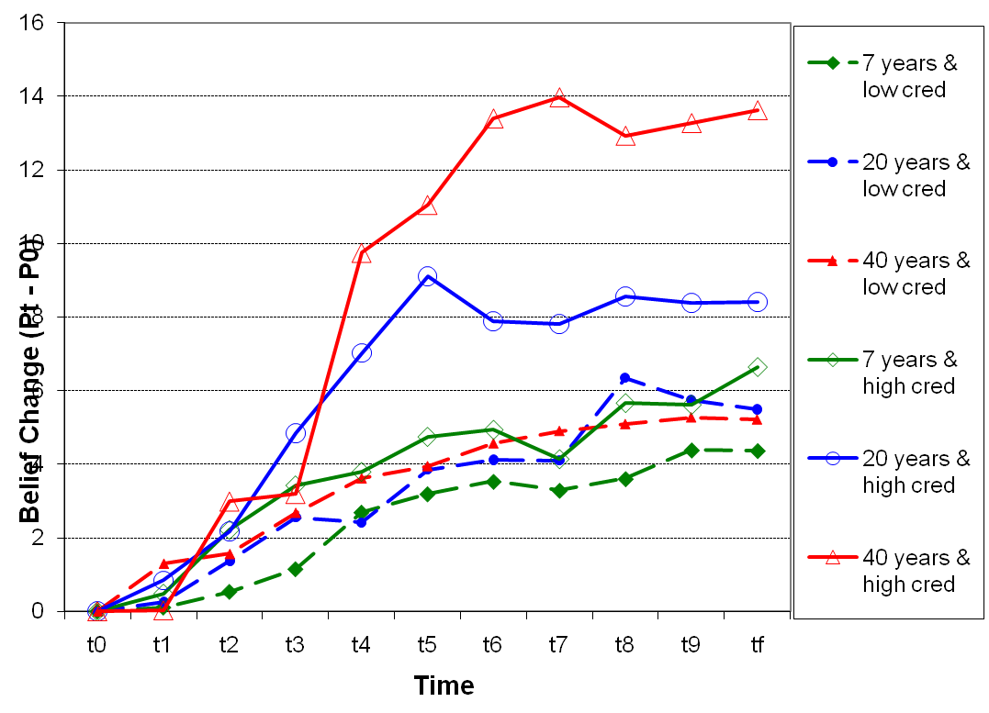
Observed Trajectories: Criminal-Sentencing Issue

Slide 19
Evidence Regarding the Single Push with Pullback Model
All 12 trajectories tested (credibility [2] x discrepancy [3] x topic [2]).
None exhibited significant nonmonotonicity.
Conclude that single push with pullback model untenable.

Slide 20
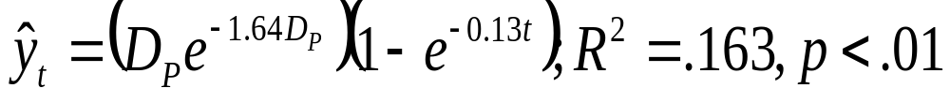
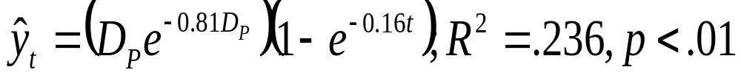
Testing the SPF model: The Criminal-Sentencing Issue
Analysis: Nonlinear regression with pooled cross-sectional time series data.
Low-credibility condition
H1 (b > 0): b = 0.13, sig.
H2a (γ > 1.0): γ = 1.64, sig.
High-credibility condition
H1 (b > 0): b = 0.16, sig.
H2b (0 < γ < 1):
γ = 0.81, sig.

Slide 21
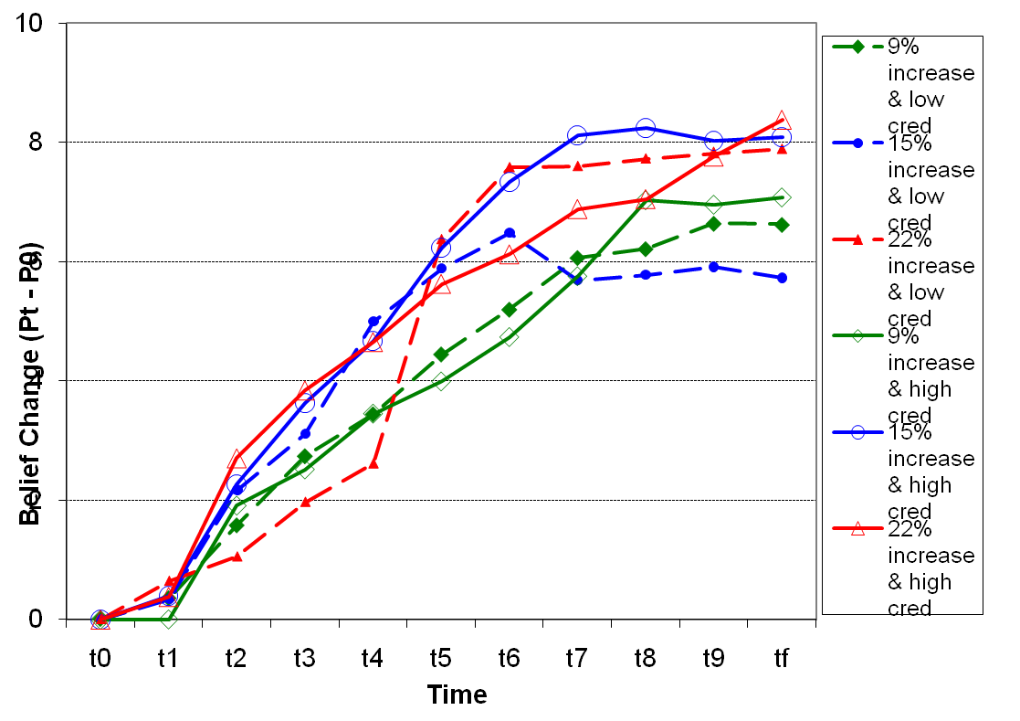
Observed Trajectories:
The Tuition-Increase Issue

Slide 22
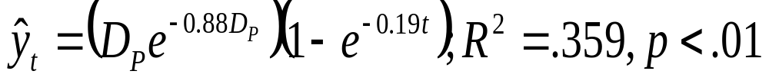
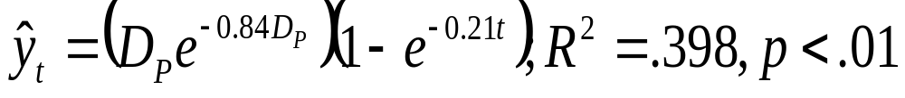
Testing the SPF model: Tuition-increase Issue
Analysis: Nonlinear regression with pooled cross-sectional time series data.
Low-credibility condition
H1 (b > 0): b = 0.19, sig.
H2a (γ > 1.0): γ = 0.88.
High-credibility condition
H1 (b > 0): b = 0.21, sig.
H2b (0< γ < 1):
γ = 0.84, sig.

Slide 23
Notes on Nonlinear Regression
Lack of independence among units (11 time points x 95 persons).
Model also tested with addition of dummy variables for persons.
Results replicated in these analyses.

Slide 24
Discussion: Implications
Dynamics: beliefs continued to change until the new equilibrium was reached.
Self-generated attitude change model (Tesser, 1978).
Laroche’s model.
Single push with friction model.
The role of time: practical implication.
Method: Belief trajectories.
Notes:
Beliefs continued to change until the new equilibrium was reached.
The pattern of belief change during judgment was found to be consistent with the self-generated attitude change model (Tesser, 1978) in that beliefs gradually shifted in one direction.
Partially confirmed prior findings that the relationship between message discrepancy and belief change is nonmonotonic for low-credibility sources and monotonic (and positive) for high-credibility sources (supported only by the criminal-sentencing data);
The single-push with friction model predicted that, for high-credibility source messages, the effect of message discrepancy on beliefs increases over time, and this effect was found.

Slide 25
Discussion: Limitations
No test of oscillatory pattern of belief change.
Level of involvement differed by topic, but involvement not manipulated.
The role of cognitive responses.
Notes:
In the present study, belief positions at 11 time points were selected to be analyzed. As a result, some information in the belief trajectories was lost. Because of the method employed in the present study, any oscillatory pattern of belief change could not be analyzed.
Two issues with different levels of personal involvement, the criminal-sentencing issue (low personal-involvement) and the tuition-increase issue (high personal-involvement), were used.
One mechanism that may help explain belief change during judgment could be the generation of cognitive responses. If cognitive responses were effectively measured, the relationships between cognitive responses and belief trajectories could be examined. In future research, the relationship between belief trajectories and cognitive responses during judgment should be investigated.

